Slide 1
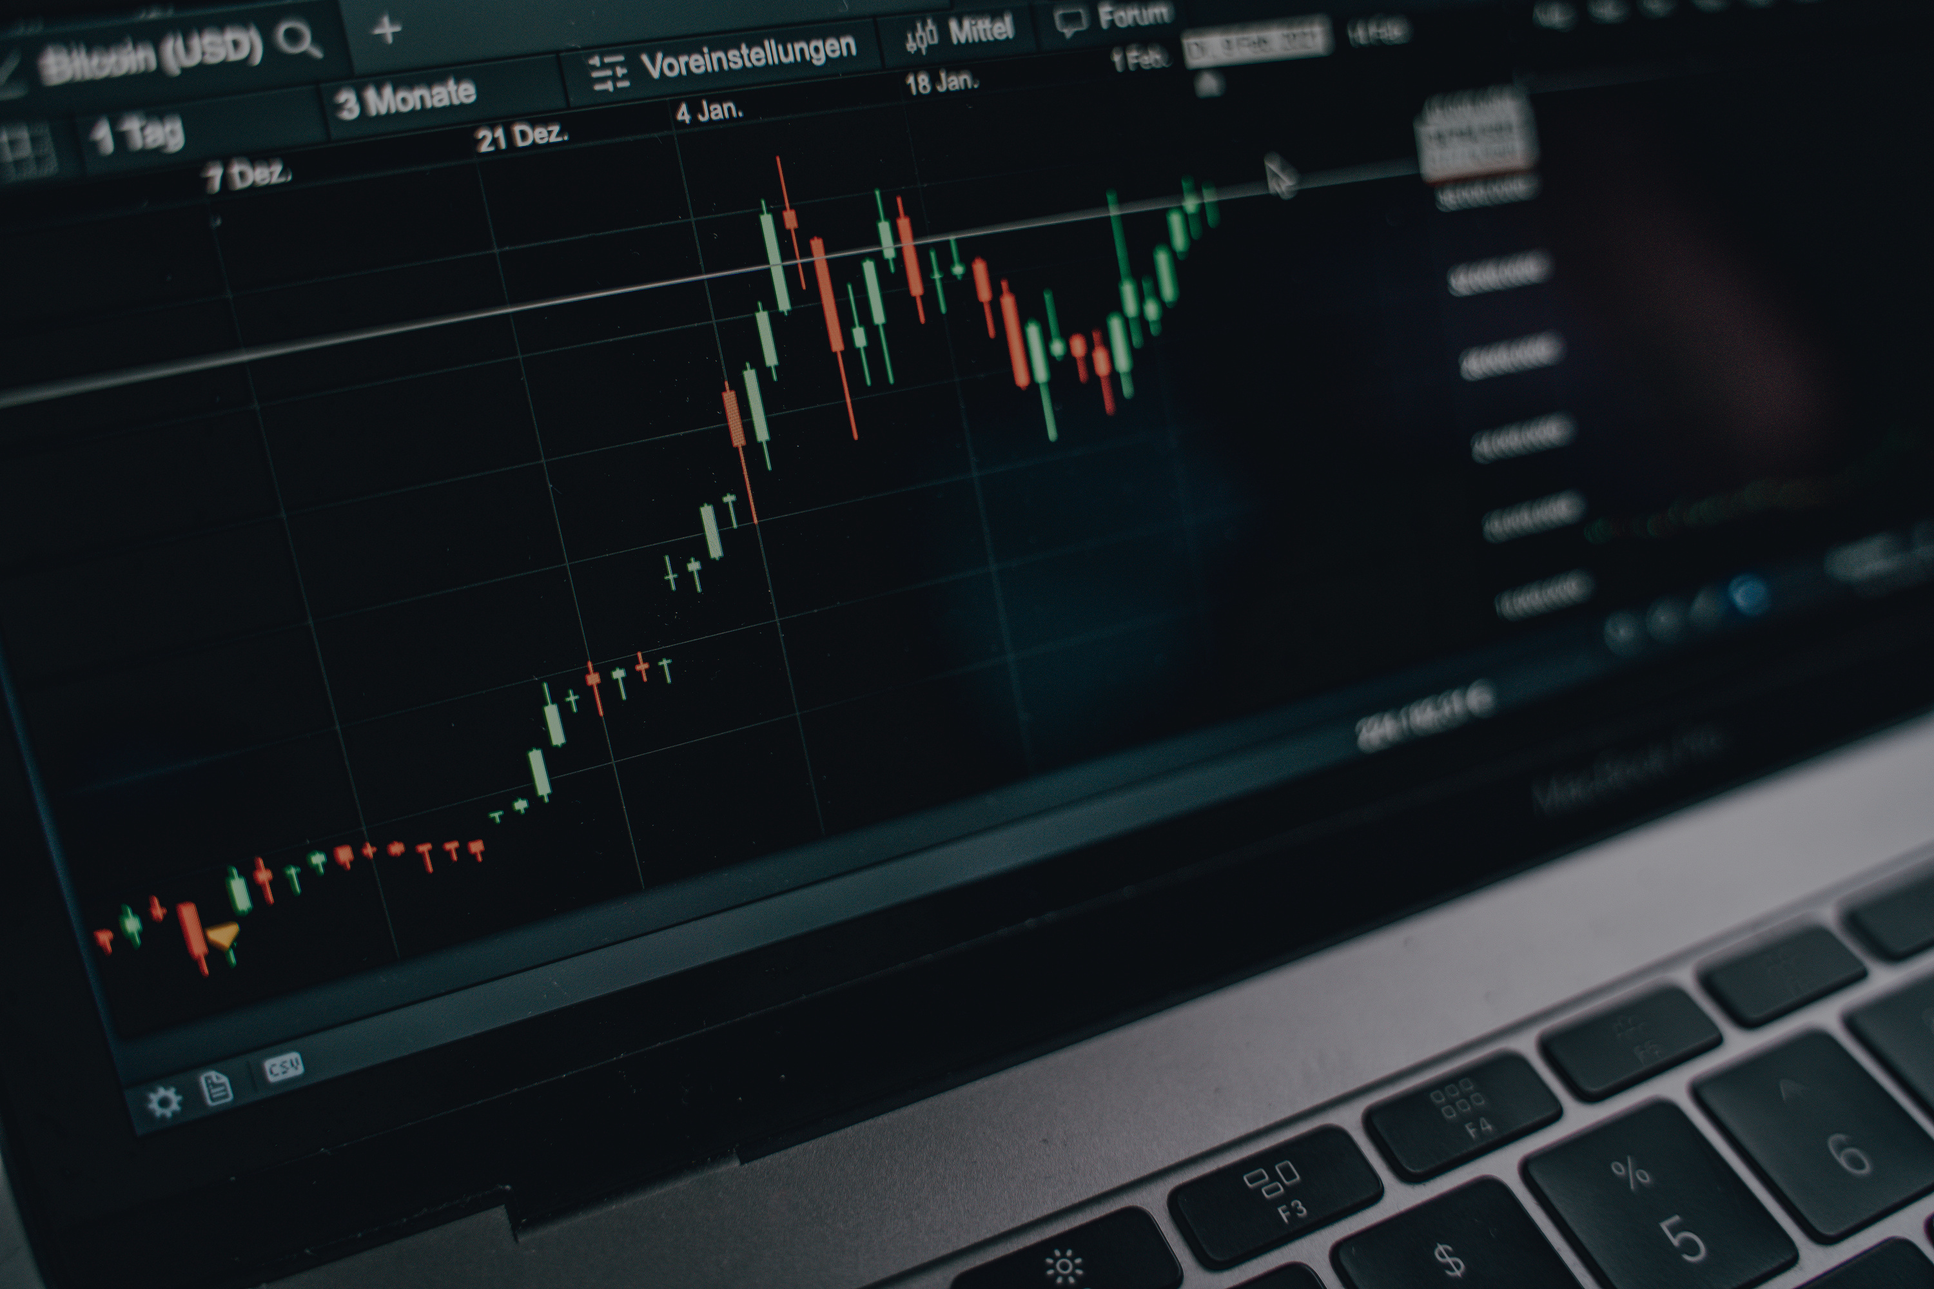
STOCK
INVESTMENT
STRATEGY
TEAM BEIJING
MARCH 29, 2025

Slide 2

AGENDA
01
EXECUTIVE SUMMARY
PROJECT OVERVIEW
02
DATA OVERVIEW​
03
04
MACHINE LEARNING
MODEL PERFORMANCE
05
06
BACK TESTING
07
GPT VS ML STRATEGY
08
KEY INSIGHTS AND RECOMMENDATIONS

Slide 3
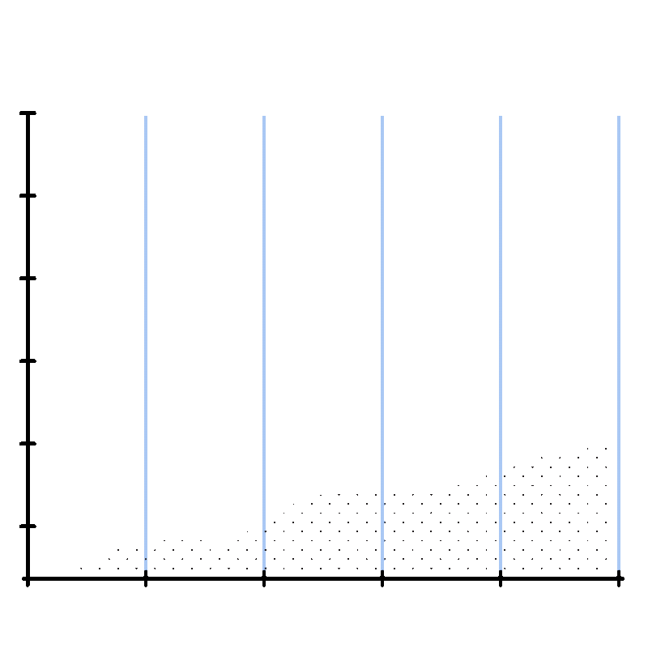
DARES EXECUTIVE SUMMARY
WHO ARE WE:
Expert Data Analytics and Research team in a large financial investment company
BUSINESS GOAL:
To launch an AI-driven stock strategy product
WHY:
Competitive pressure + failed previous attempt (AI-Cons)
WHAT WE BUILT:
Predictive ML model + GPT comparison
RESULTS:
Proven Results in Future & BackTesting

Slide 4
PROJECT OVERVIEW & CONTEXT
EXCLUDED SECTORS
Financials
Real Estate
Utilities
ANALOGY
Horse race → predicting future winners using past traits
QUESTIONS ASKED BEFORE TACKLING THE PROBLEM
Winners and Losers
Classification or Regression
Training, Testing and Validation
Redundant Features
USE OF HISTORICAL STOCK DATA TO PREDICT WINNERS

Slide 5
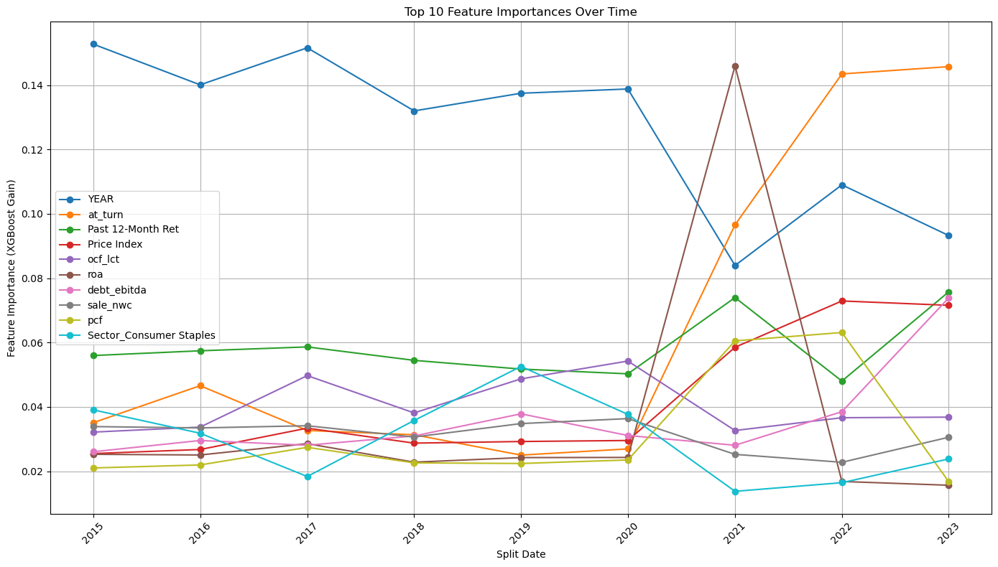
DATA OVERVIEW
01
DATA SOURCE
CRSP/Compustat-style financials
02
TIME SPAN & FREQUENCY
Data ranges from 2015 - 2023
Used split_date
simulates real-world conditions
03
FEATURES
Ratios
Past returns
Sector indicators
04
TARGET VARIABLE
Forward 3-month returns

Slide 6


DATA PREPROCESSING &
EDA
CREATING WINNER LABELS (TOP 30)
NORMALIZATION USING
STANDARDSCALER
CROSS-SECTIONAL + TIME-SERIES CHALLENGES
MERGING, CLEANING, FILTERING

Slide 7


ML PROBLEM FRAMING
PREDICTION MODEL TYPE:
Regression
CHOSEN MODELS:
XGBoost Regressor
WHY THE CHOSEN MODELS?
Interpretability, regularization, simplicity
MOVING WINDOW FOR TIME-CONSISTENCY

Slide 8

ML MODEL DESIGN & IMPLEMENTATION
PREVENTS LOOKAHEAD BIAS
MODEL TYPE & OBJECTIVE
Used XGBoost Regressor to predict transformed forward 3-month returns.​
Selected due to its performance with tabular data, feature importance capabilities, and robustness to noise and missing values.
FEATURE SET & PREPROCESSING
Input features include past returns, valuation ratios, profitability metrics, and liquidity indicators.​
Applied log transformation to stabilize return distributions and StandardScaler for normalization.
ROLLING WINDOW APPROACH
Trained model on data prior to each target date using a realistic 3-year rolling window and predicted for the target quarter.​
Prevents lookahead bias and mirrors real-world investment workflows.
PREDICTION OUTPUT & STORAGE
For each test quarter (e.g., Jan 2021, Jan 2022, Jan 2023), generated predicted return values for all stocks.​
Results stored in separate Excel sheets, used to rank and select Top 30 winners and Bottom 30 losers.

Slide 9

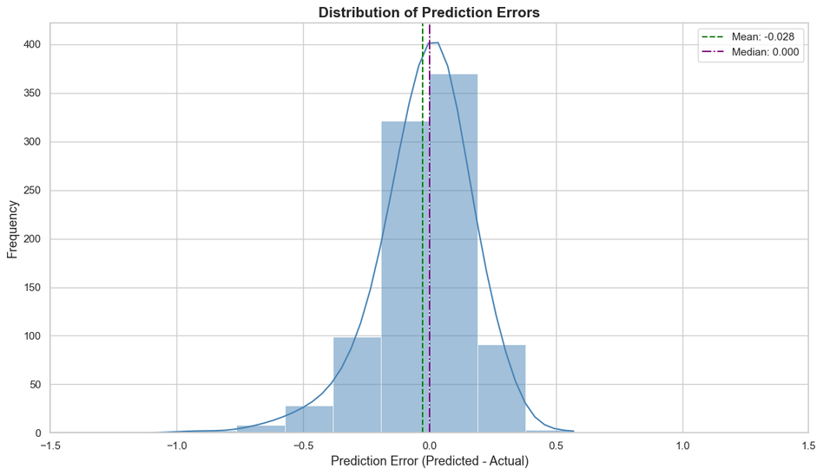
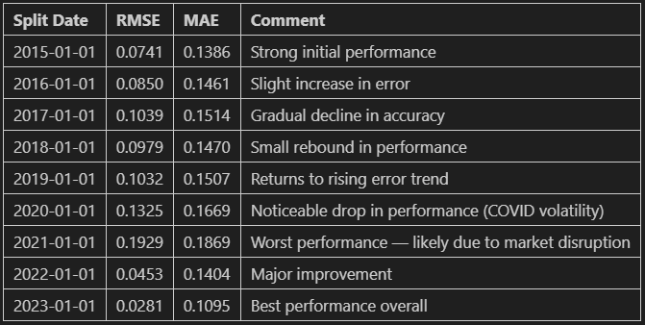
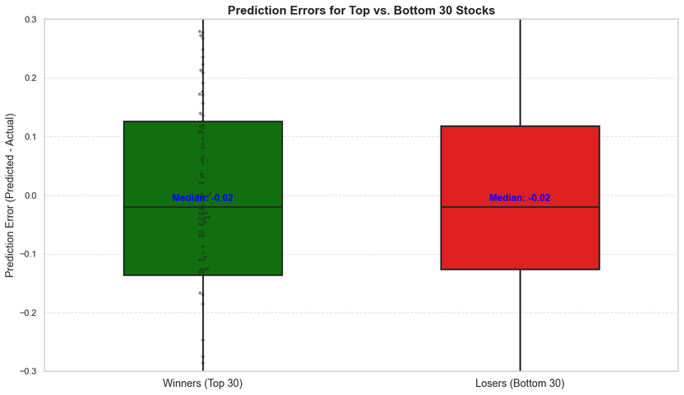
MODEL PERFORMANCE
STATISTICAL SIGNIFICANCE OF RESULTS
Used Root Mean Squared Error (RMSE) and Mean Absolute Error (MAE) as model evaluation metrics Prediction errors results show market volatility during pandemic years Performance peaks from 2015 - 2017 and shows downward trend from 2018 - 2021 2022 - 2023 shows performance recovery

Slide 10
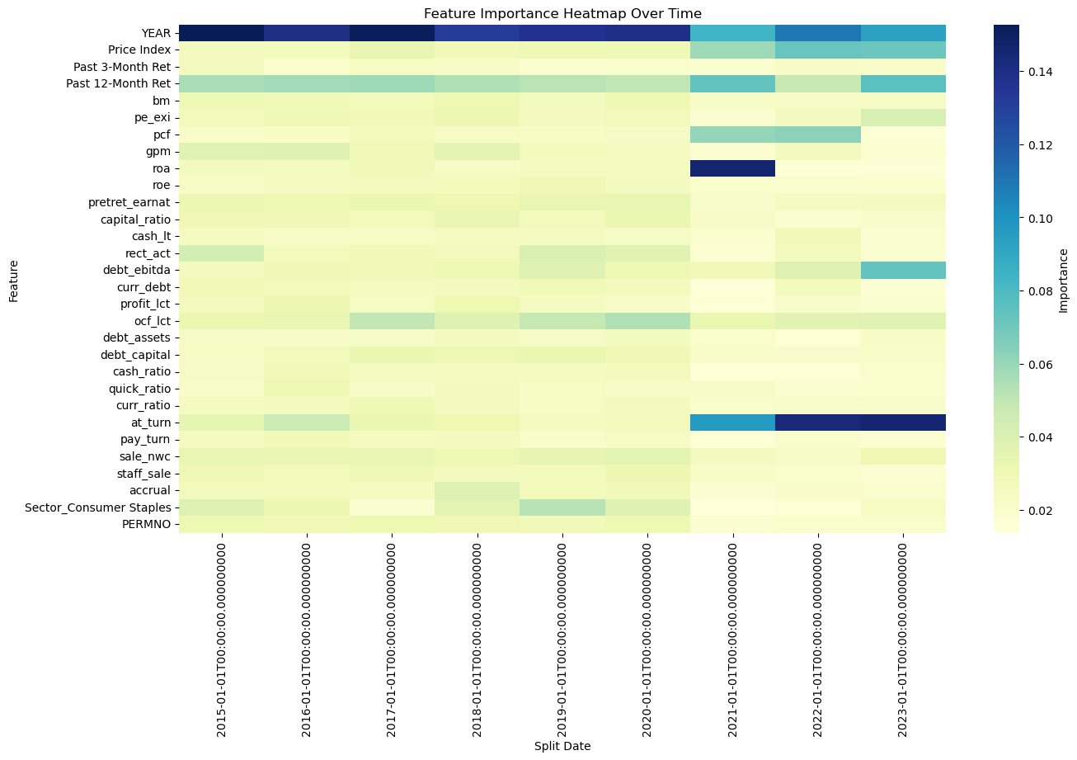
FEATURE IMPORTANCE
Visulizes how the relative importance of each feature evolves across rolling time windows in our model
KEY OBSERVATIONS
Price Index and Past Returns (3- Months and 12 - Months) consistently held moderate importance
Features such as pre-tax return, asset turnover and cash over total liabilities showed localized spikes in importance around years 2021 - 2022
Sector information and accrual-based metrics had low and stable influence

Slide 11
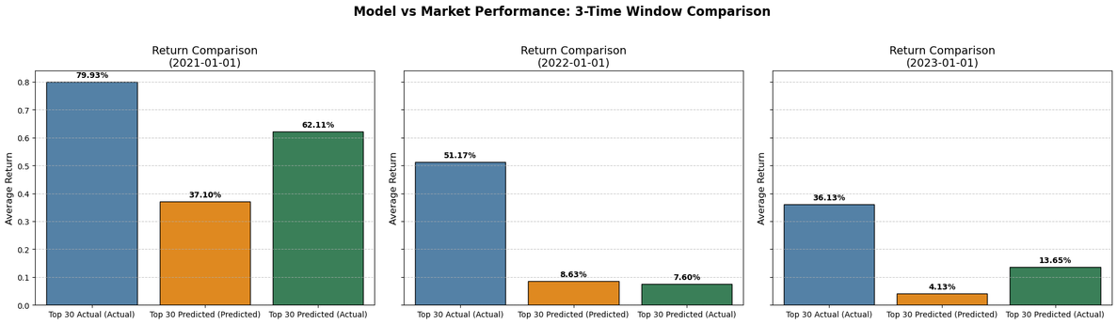

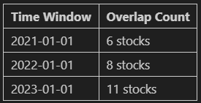
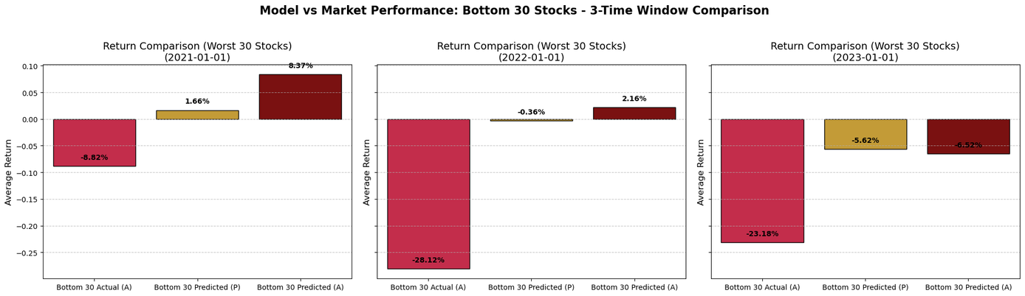
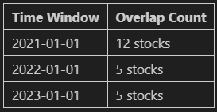
BACKTEST RESULTS
CUMULATIVE RETURNS: PREDICTED TOP 30 VS BOTTOM 30
MODELS ABILITY TO IDENTIFY WORST - PERFORMING STOCKS
Bottom 30 Actual (Actual): True bottom performers
Bottom 30 Predicted (Predicted): Stocks forecasted to perform worst
Bottom 30 Predicted (Actual): Actual returns of the model’s bottom 30 predictions
COMPARISON OF THE AVERAGE RETURNS OF BEST - PERFORMING STOCKS
Top 30 Actual (Actual): Best performers by actual forward 3-month return
Top 30 Predicted (Predicted): Stocks forecasted by the model to perform best
Top 30 Predicted (Actual): Actual returns of those top 30 predicted stocks

Slide 12
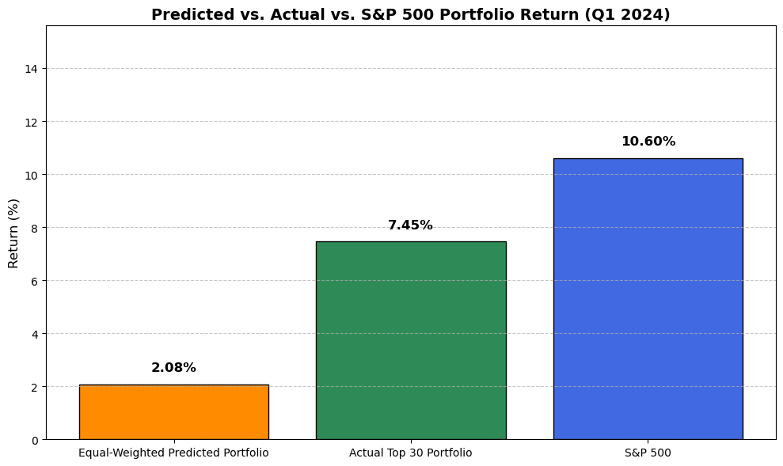
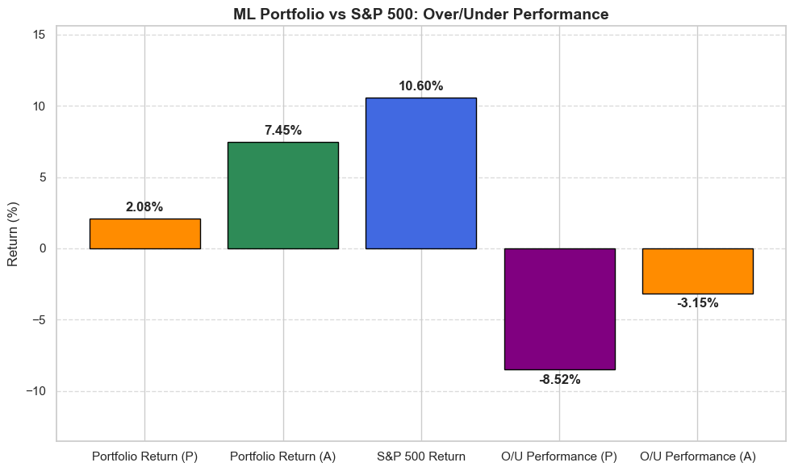
2024 REAL PORTFOLIO TEST
01
ML-PREDICTED PORTFOLIO SIGNIFICANTLY UNDERPERFORMED THE BENCHMARK
02
ACTUAL TOP 30 STOCKS TRAILED THE INDEX
03
HIGHLIGHTS THE IMPORTANCE OF DYNAMIC MODEL ADAPTATION AND MARKET REGIME AWARENESS WHEN DEPLOYING PREDICTIVE STRATEGIES

Slide 13

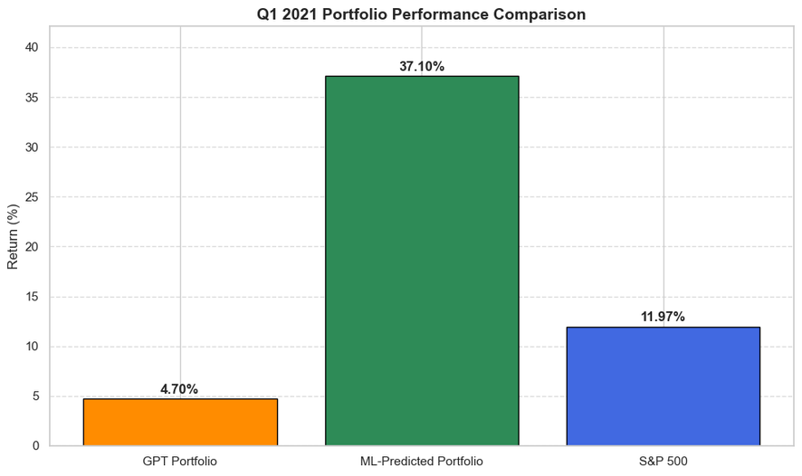
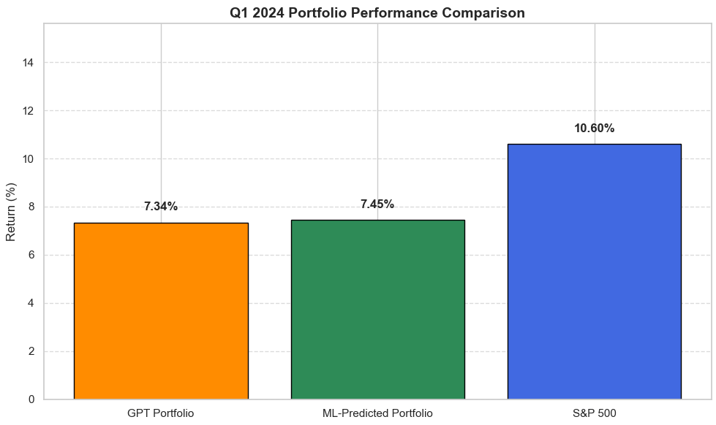
GPT VS ML
STRATEGY
01
Prompt examples + GPT reasoning:
Financial AI advisor operating on Dec 31, 2023
Select 30 stocks that you expect will perform well in Q1 2024 based on publicly available data
GPT-selected portfolios:
02
Tech industry tickers: MSFT, AAPL, ORCL, GOOGL
Retail industry tickers: AMZN, NKE
Other industry tickers: META, TSLA
03
Performance comparison:
S&P 500 is the most reliable and stable performer
GPT-Based Strategy presents a compelling middle ground
ML-Based Strategy offers the highest potential

Slide 14

KEY INSIGHTS & RECOMMENDATIONS
ML Models Show Promise, but Require Further Refinement
GPT Is Surprisingly Competitive & Adds Strategic Value
No One-Size-Fits-All: Model Signals May Be Regime-Dependent
Product Not Market-Ready Yet: But Foundation Is Strong

Slide 15

Q&A
Thank You
TEAM BEIJING

